Slide 1

RESUME CLASSIFICATION USING NLP and ML
Team Members
E . Jaya Prakash NarayanaRao
SHAIK ZABRULLA BASHA
Jiban Jyoti Das
Falak Hashmi
Kowmudi Chavali
Muskan Doddamani

Slide 2
Business Objective
The Resume classification solution should significantly reduce the manual human effort in the HRM .It should achieve a higher level of accuracy and automation with minimal human intervention.
Reduce manual effort in resume screening.
Automatically classify resumes by job role.
Achieve high accuracy with minimal human intervention.
Improve accuracy and minimize human involvement.
Streamline the recruitment process using machine learning.

Slide 3
ABSTRACT
This project presents an automated solution for resume classification using Natural Language Processing (NLP) and Machine Learning (ML) techniques. The system processes resumes, extracts key textual features using TF-IDF and CountVectorizer, and applies ML algorithms such as Logistic Regression, Naive Bayes, and SVM to categorize resumes into predefined job roles. This improves accuracy and reduces manual effort in HR screening, enhancing recruitment automation.
The dataset consists of resumes labeled into multiple job categories, enabling supervised learning. Various text cleaning and preprocessing techniques were applied to ensure high-quality feature extraction. The models were evaluated using metrics like accuracy, F1-score, and confusion matrix to ensure robust performance. This approach not only speeds up candidate filtering but also provides scalable and intelligent support for HR decision-making.

Slide 4
Project Architecture
Collection of Data
Business Understanding
Exploratory Data Analysis(EDA)
Deployment
Model Building

Slide 5
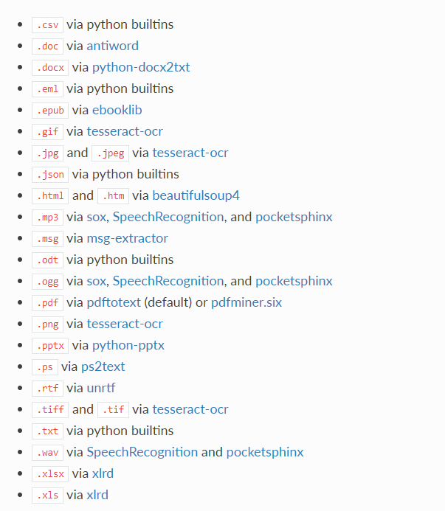
Textract
This package provides a single interface for extracting content from any type of file, without any irrelevant markup. This package will help us to Convert All kind format resume into Docx Format .

Slide 6
Data Preprocessing
Steps Performed:
Converted Doc and PDF files into Docx .
Merged All categories and Created CSV file.
Removed: URLs, emails, punctuation, and stopwords
Applied: Tokenization, stemming, lemmatization
Output: Cleaned resumes used for feature extraction

Slide 7
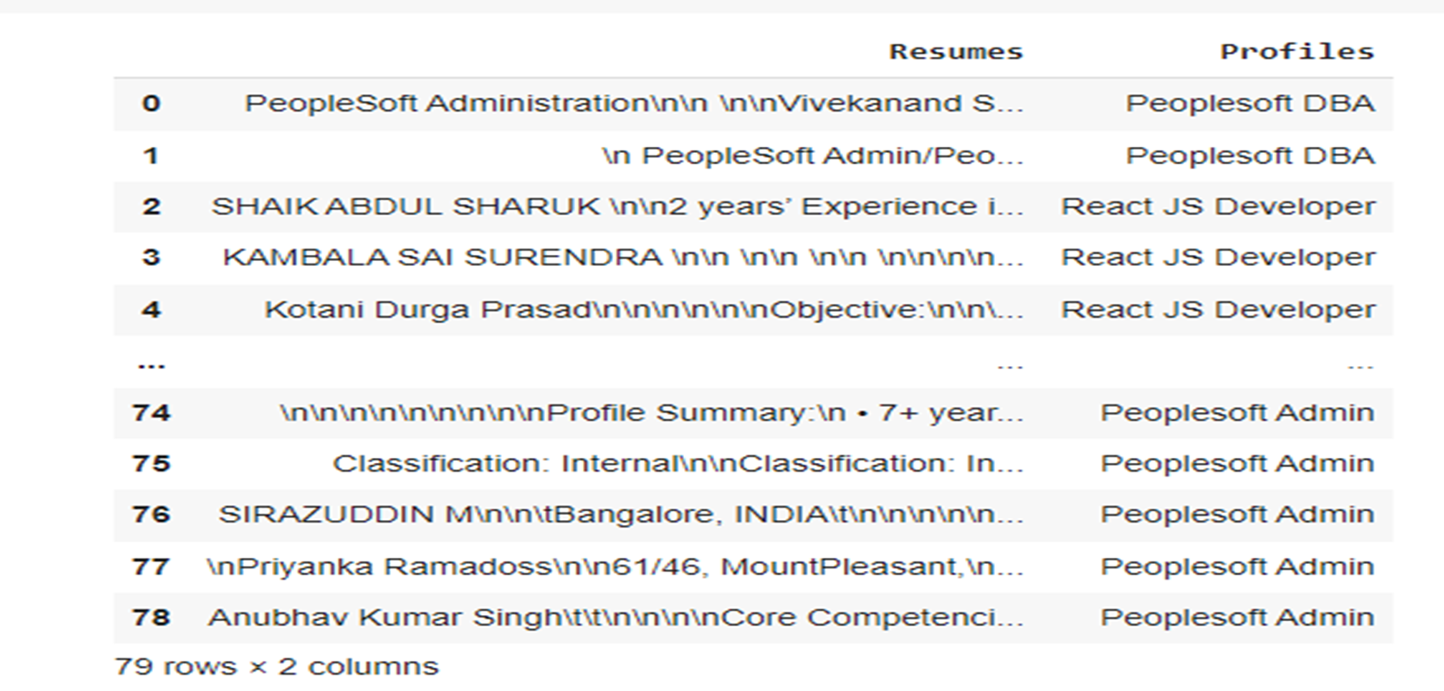
Csv Data Set

Slide 8
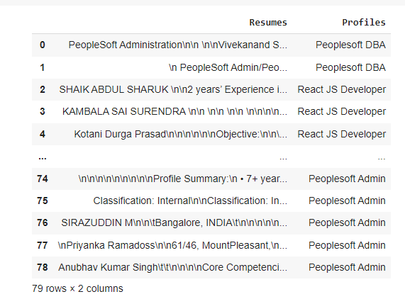
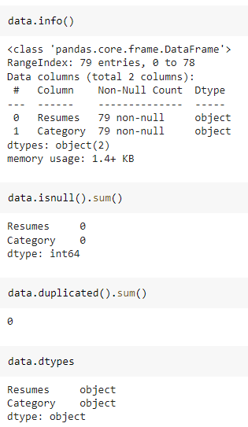
DATA Set Details
After Extracting and Modifying the Dataset, given data contains a total of 4 Classes and 79 rows .

Slide 9
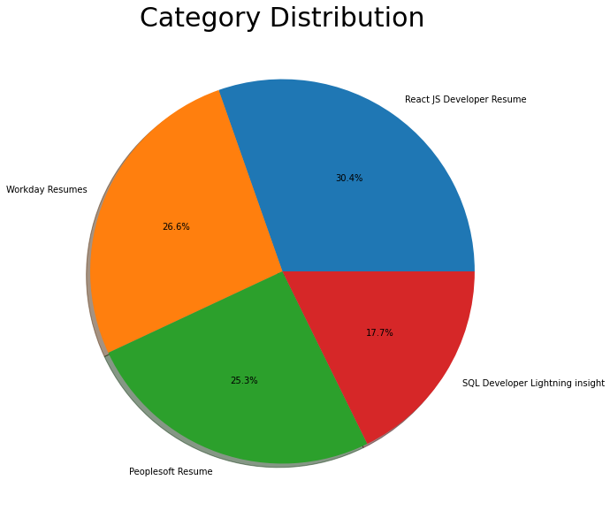
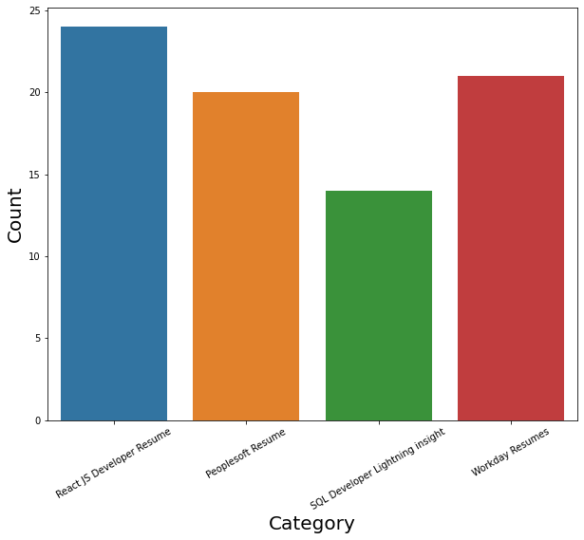
Exploratory Data Analysis (EDA)
By using Pie chart roles applied feature is displayed to visualize the job roles.
By using Histogram roles applied feature is displayed to check the job types.

Slide 10
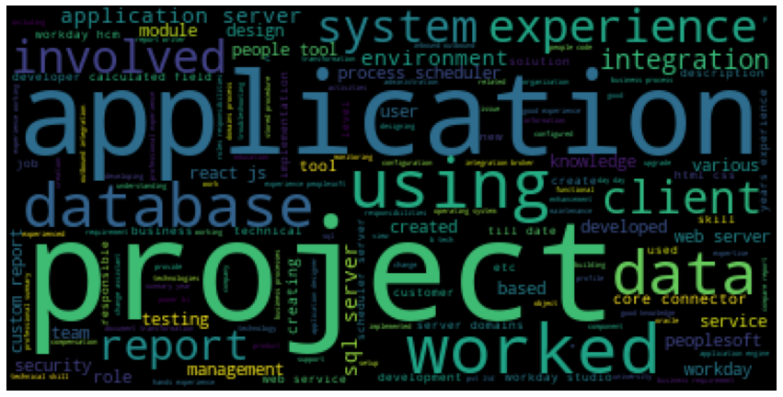
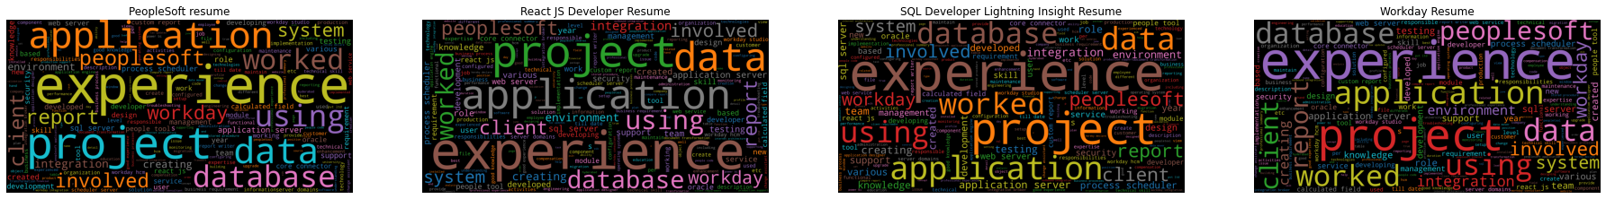
Word Cloud

Slide 11
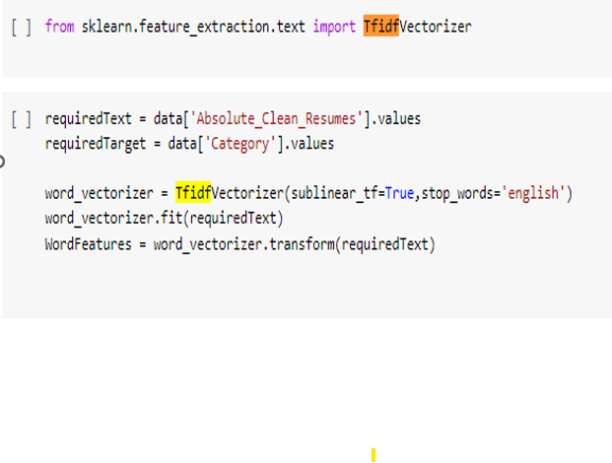
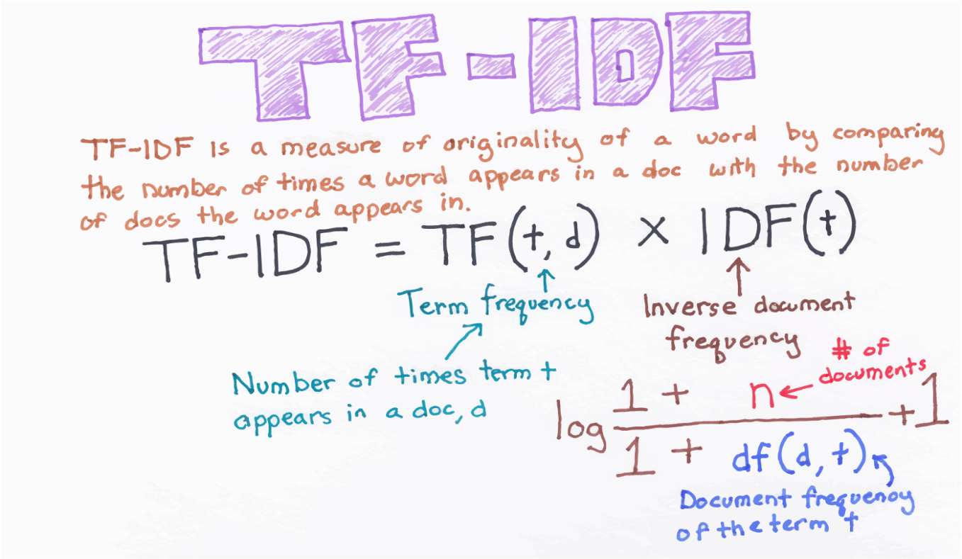
Model Building :– tf -idf
TF-IDF is better than Count Vectorizers because it not only focuses on the frequency of words present in the corpus but also provides the importance of the words.
We can then remove the words that are less important for analysis, hence making the model building less complex by reducing the input dimensions.

Slide 12
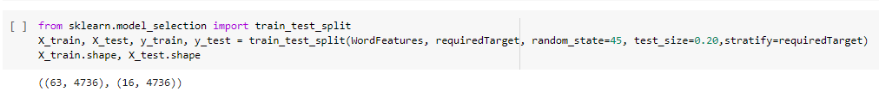
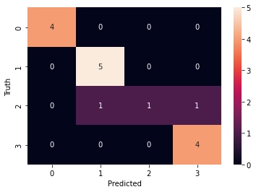
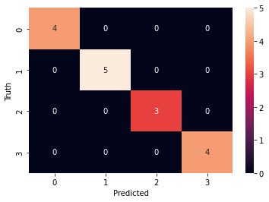
Before Stratified Sampling
Train & Split
4
5
3
4
After Stratified Sampling

Slide 13
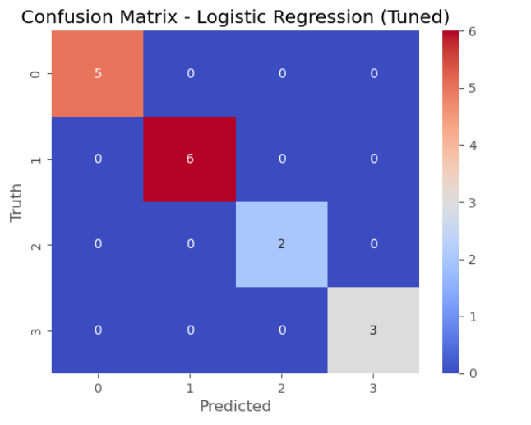
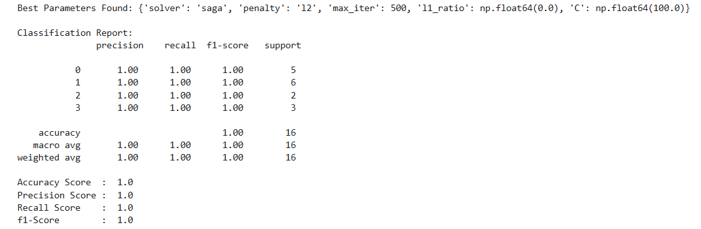
Models
Algorithms Used:
Logistic Regression (with hyperparameter tuning)

Slide 14
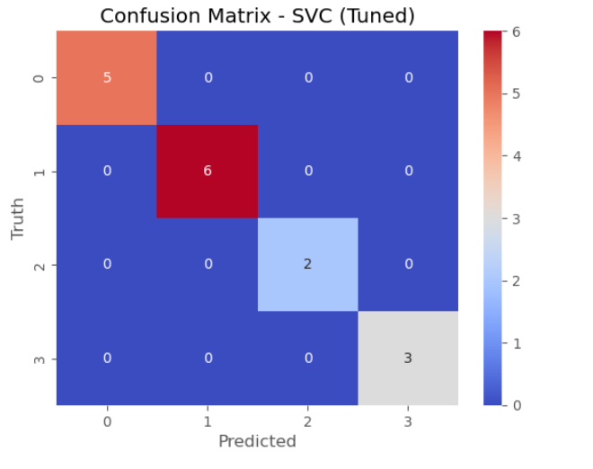
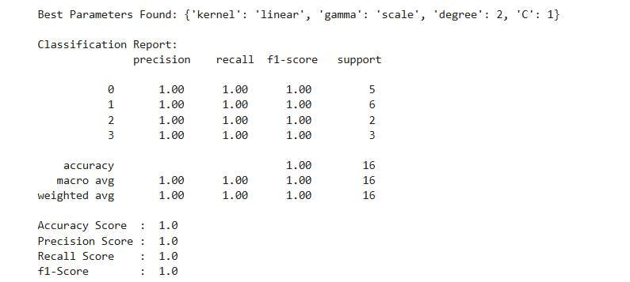
Models
Algorithms Used:
Support Vector Classifier (SVC) (with hyperparameter tuning)

Slide 15
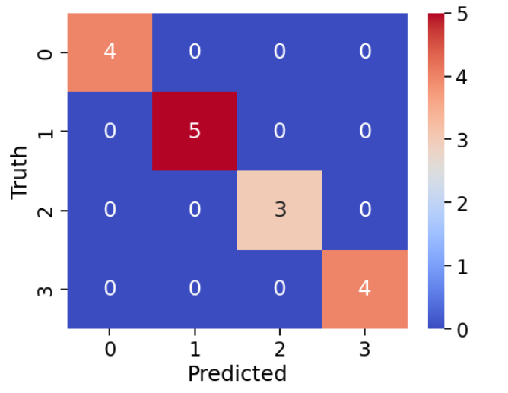
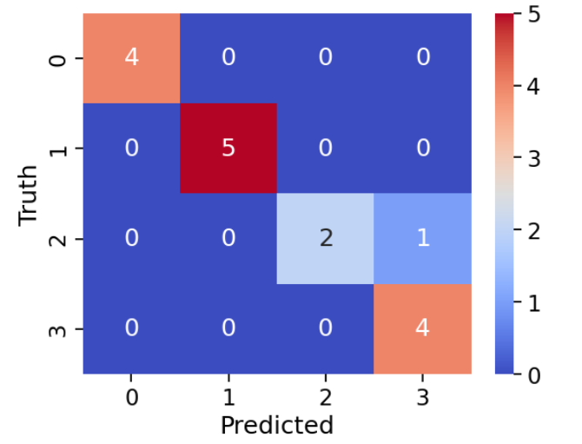
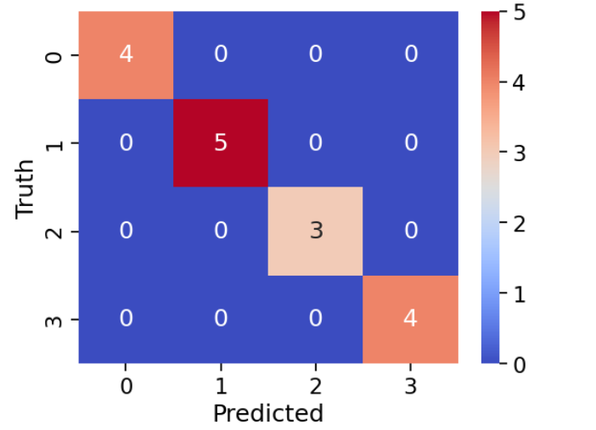
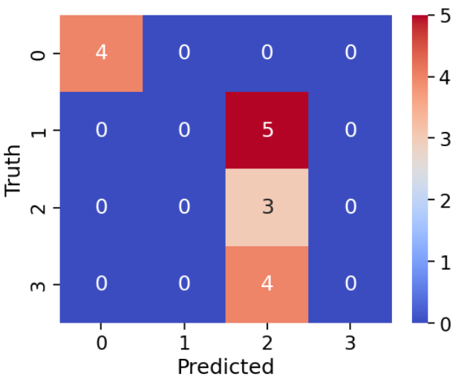
Random Forest Classifier
Naïve Bayes Classifier
Here, we have taken Model building algorithms such as Decision Tree Classifier, Naïve Bayes, Adaboost, Random , Forest, etc.
Among these algorithms, 100% Accuracy, Precision, Recall and F1-score have been achieved.
100% accuracy is achieved by using the model Random Forest, Decision Tree and Gradient Boosting Classifier.
Decision Tree Classifier
AdaBoost Classifier

Slide 16
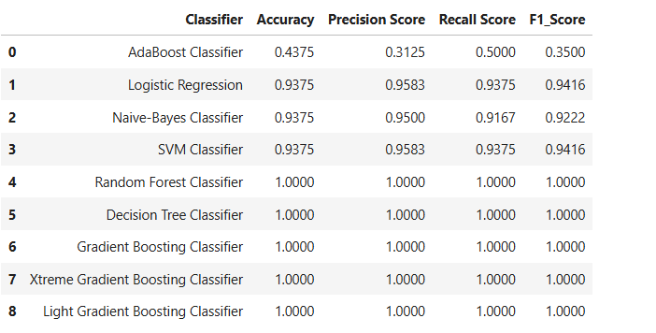
Models Evaluation
Here, we have taken Model building algorithms such as Decision Tree Classifier, Logistic Regression, SVM, Random , Forest, etc.
Among these algorithms, 100% Accuracy, Precision, Recall and F1-score have been achieved.
100% accuracy is achieved by using the model Random Forest, Decision Tree and Gradient Boosting Classifier.

Slide 17
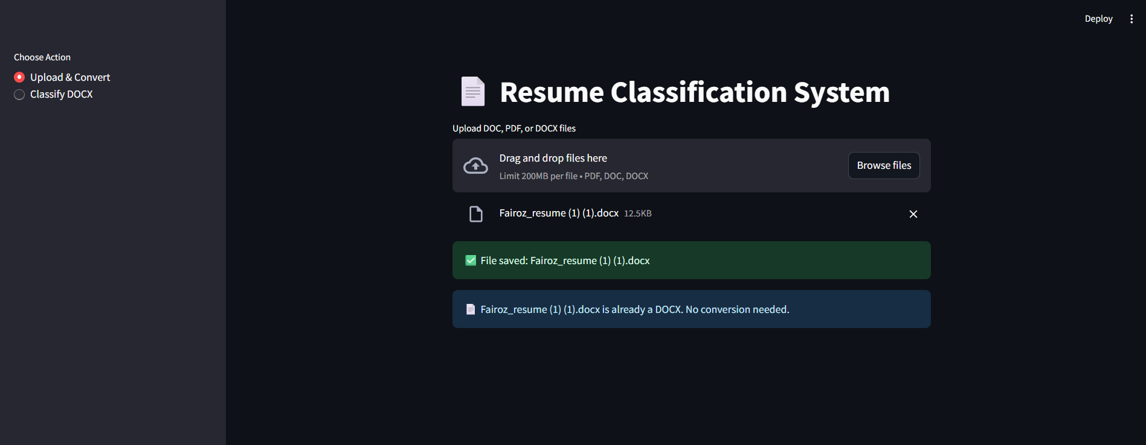
Deployment
Here, we have taken Logistics Regression as our Final Model algorithms for the deployment.
The algorithm has achieved 100% Accuracy, Precision, Recall and F1-score on testing data.
We have deployed the Resume Classification using Stream-lit as the platform

Slide 18
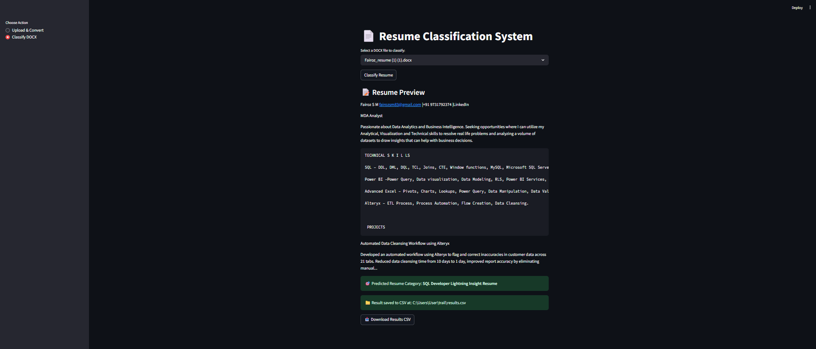
Deployment

Slide 19
Thank you

